Slide 1

Introduction to linear models
Of course I’m $Normal$

Slide 2
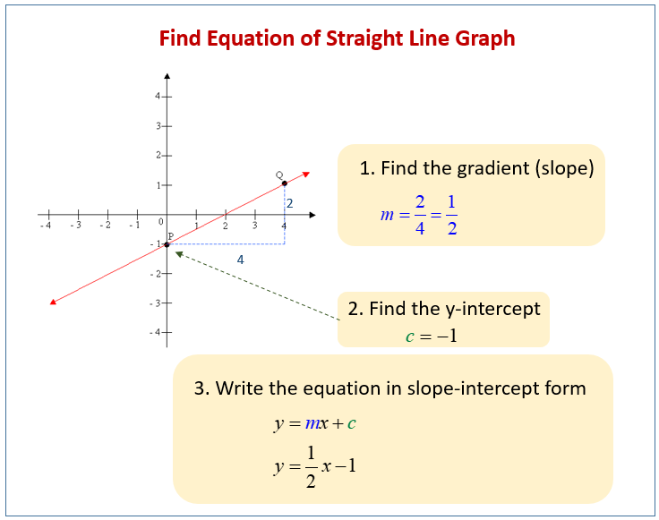

Stats: making the simple seem complicated
Statistics is all about finding associations
  When temperature increases, what happens to survival?
  What is the average number of kittiwakes in Site A and Site B?
The maths is pretty simple
  Intercepts and slopes
  Or multiple averages
Some form of:
$$y=mx+c$$

Slide 3
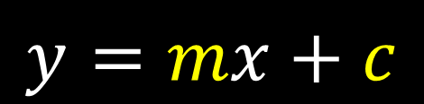
Statistics and data
$$y=mx+c$$
Continuous (e.g. height)
Observed
Grouped
(e.g. eye colour)
Data
Unobserved
“Parameter”

Slide 4

Statistics and data
$$y_{i}=β_{0}+β_{1}×x_{i}$$
Continuous (e.g. height)
Observed
Grouped
(e.g. eye colour)
Data
Unobserved
“Parameter”

Slide 5
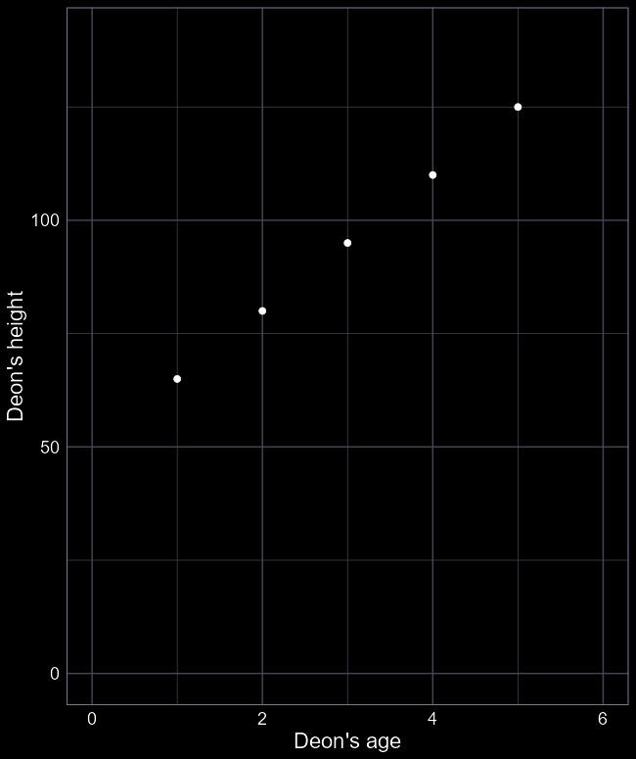

Doing “stats” by hand
Your straight-line equation:
$$y_{i}=β_{0}+β_{1}×X_{i}$$
  $y_{i}$ = Deon’s height
  $X_{i}$ = Deon’s age
  $β_{0}$ = y-intercept
  (I was $β_{0}$ cm tall when I was born)
  $β_{1}$ = Slope
  (aging 1 year increased my height by $β_{1}$ cm)
Observed data
Unobserved data
$i$ is an index; e.g. if $i=1$ then this is the first observation

Slide 6
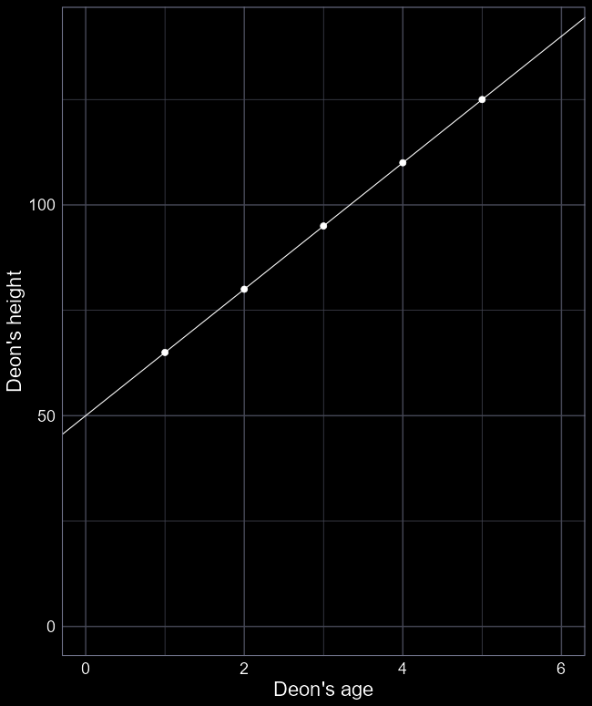



“Stats” by hand
Deon’s height = $β_{0}+β_{1}×$ Deon’s age
What is $β_{0}$?
Imagine a line extending down to 0 years old.
$β_{0}$ = 50 cm at 0 years old
What is $β_{1}$?
How much did I grow in one year?
$β_{1}$ = 15 cm per year
We now have an association.
We can use the equation to make predictions:
How tall was I at 6 years old?
Height = 50 + 15 $×$ 6 = 140 cm
How tall will I be when I am 120 years old?
Height = 50 + 15 $×$ 120 = 1850 cm
Be very careful when predicting
75 cm
60 cm
$$β_{1}=15 cm per year$$
$$β_{0}=50 cm$$

Slide 7
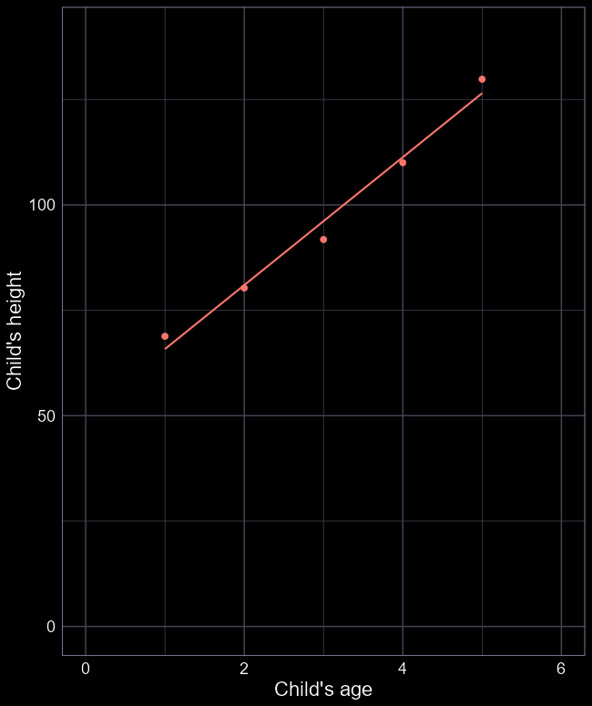
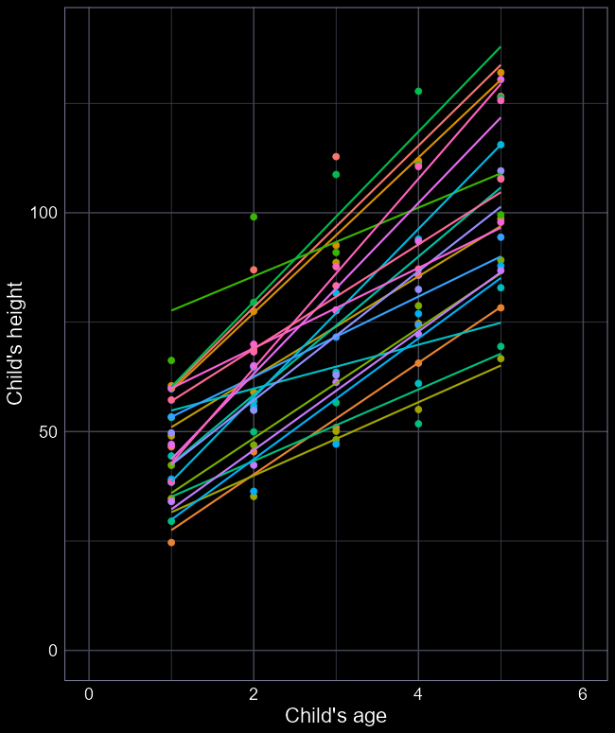
More realism
The real world is not perfect
Our predictions (i.e. the line) are never perfect
Even the same individuals have variation
  E.g. growth spurts
Different individuals are not the same
  And can vary in their own way
But we want to describe the general relationship

Slide 8
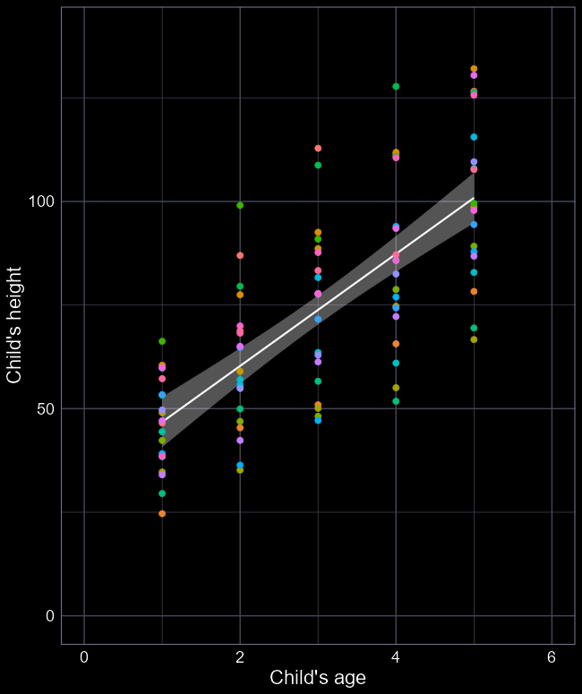

What stats does
Statistics not only deals with variation but incorporates it
Cuts through the noise to show signal
Ideally, finds the relationship we want to understand
Here:
  $\hat{β_{0}}=36.5 cm$
  $\hat{β_{1}}=14.8 cm per year$
We now have a mean that changes according to $X$
  I.e. We don’t have a single average

Slide 9
What about variation?

Slide 10
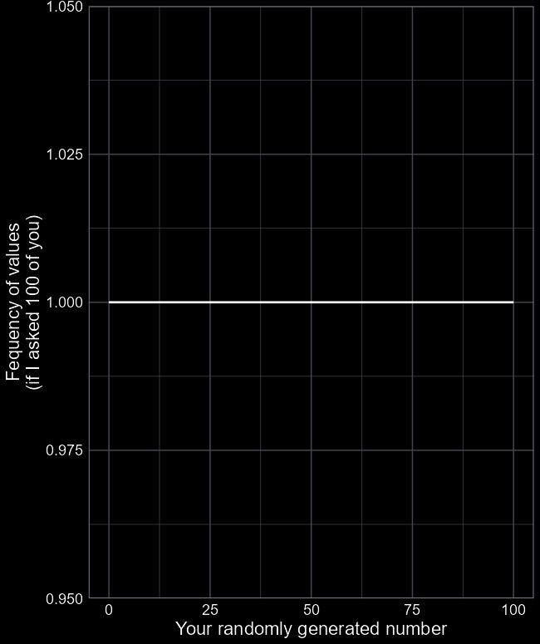
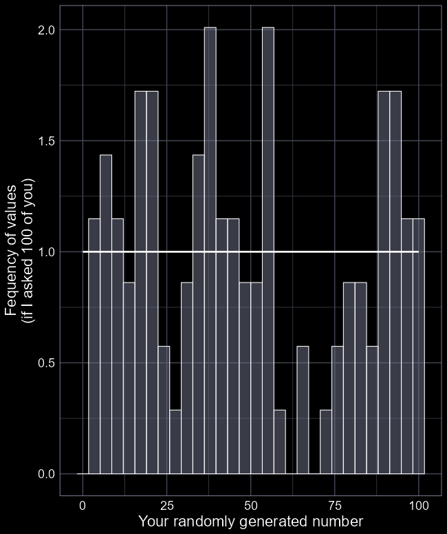

Variation
Distributions are how models deal with “randomness”
They “control” randomness so that it behaves in a way that is “sensible”
The simplest distribution is:
$$Uniform(0, 100)$$
Which says that all values are equally likely within the range 0 to 100
But the $Uniform$ distribution is so simplistic that it’s not very useful

Slide 11
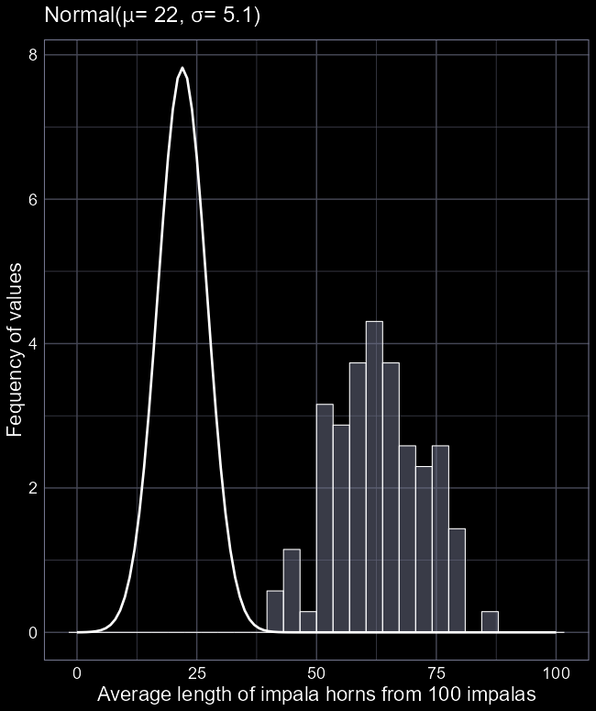
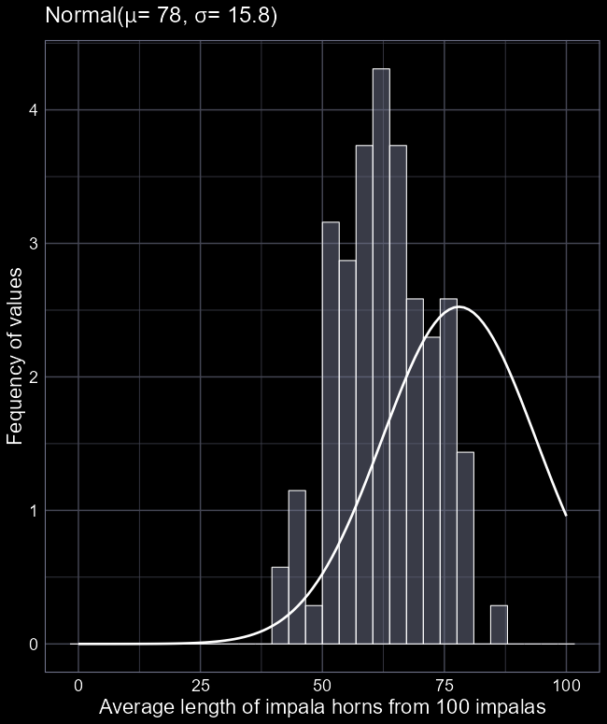
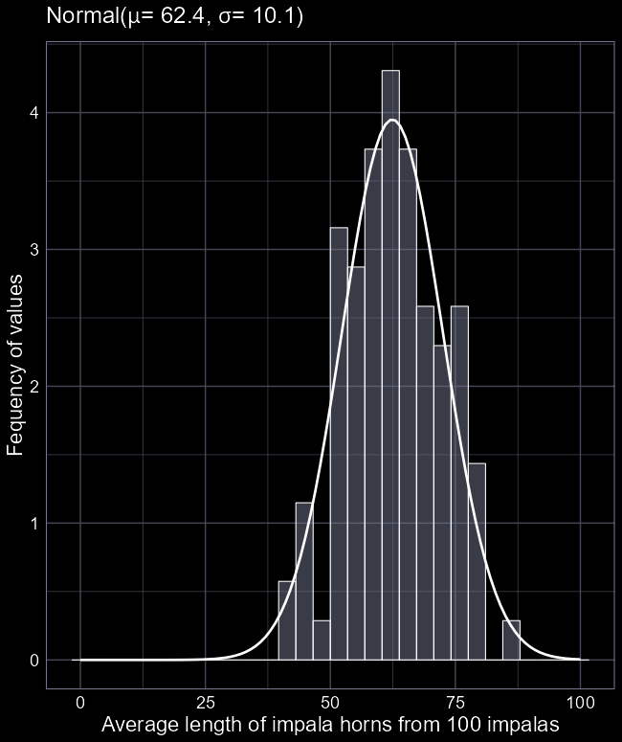


$Normal$ distribution
Called “Normal” because of how common it is in nature
  Sometimes called $Guassian$
Described with two bits of information
  The mean ($μ$)
  And the standard deviation ($σ$)
We just need to figure out which values for mean (and standard deviation) work best with our data

Slide 12
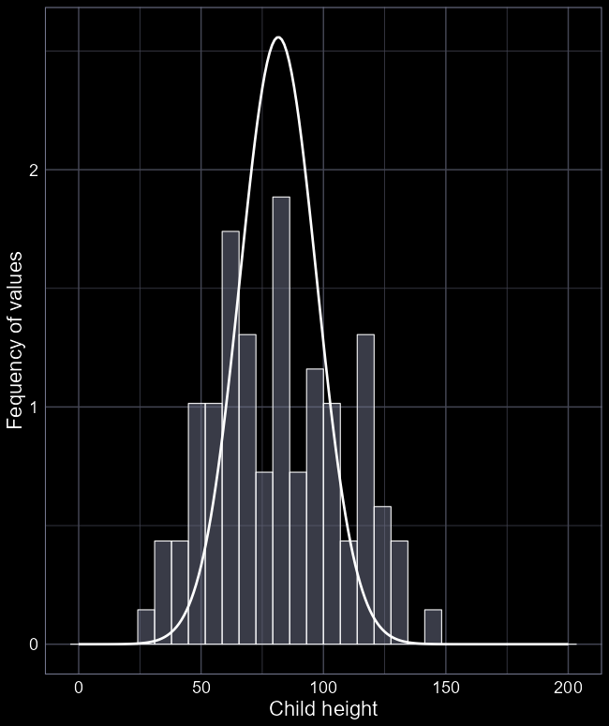

Our model
Previously we wrote:
  $${Height}_{i}=β_{0}+β_{1}×{Age}_{i}$$
More formally, we’d write:
$$Height_{i}∼Normal\left(μ_{i}, σ_{i}\right)$$
$$μ_{i}=β_{0}+β_{1}Age_{i}$$
Where:
$Height_{i}$ is the height of child $i$
“$\sim$” means “generated according to…” or “arises from…”
$Normal$ is the distribution we assume generated the $Height$ values
$μ_{i}$ is the average $Height$ we would expect for child $i$
$σ_{i}$ is the standard deviation in $Height$ we expect for child $i$
Where the average ($μ$) is:
  $β_{0}$ (height at age 0)
  $β_{1}$ (how many cm a child grows each year)

Slide 13
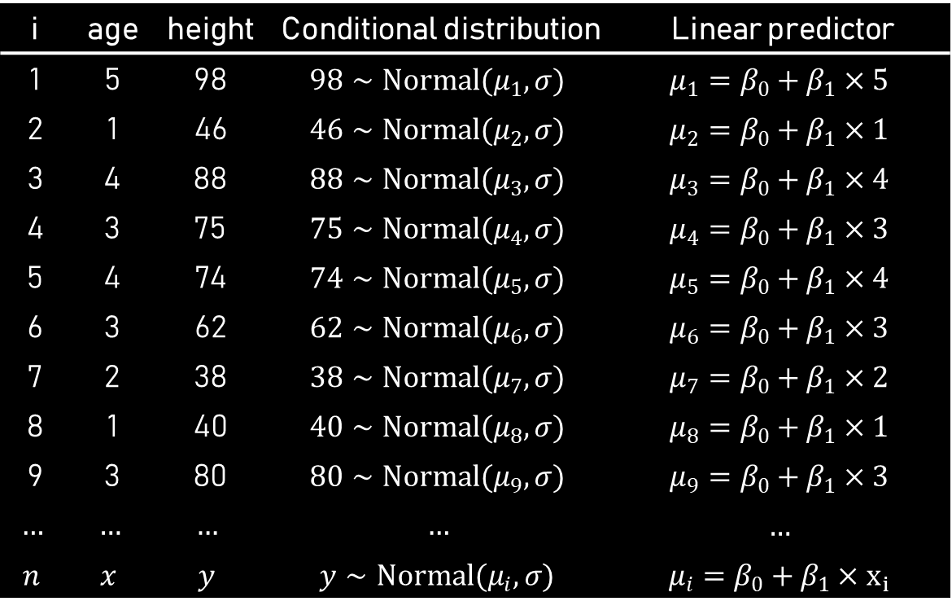
Data and model
i | age | height | Conditional distribution | Linear predictor
1 | 5 | 98 | $$98∼Normal(μ_{1}, σ)$$ | $$μ_{1}=β_{0}+β_{1}×5$$
2 | 1 | 46 | $$46∼Normal(μ_{2}, σ)$$ | $$μ_{2}=β_{0}+β_{1}×1$$
3 | 4 | 88 | $$88∼Normal(μ_{3}, σ)$$ | $$μ_{3}=β_{0}+β_{1}×4$$
4 | 3 | 75 | $$75∼Normal(μ_{4}, σ)$$ | $$μ_{4}=β_{0}+β_{1}×3$$
5 | 4 | 74 | $$74∼Normal(μ_{5}, σ)$$ | $$μ_{5}=β_{0}+β_{1}×4$$
6 | 3 | 62 | $$62∼Normal(μ_{6}, σ)$$ | $$μ_{6}=β_{0}+β_{1}×3$$
7 | 2 | 38 | $$38∼Normal(μ_{7}, σ)$$ | $$μ_{7}=β_{0}+β_{1}×2$$
8 | 1 | 40 | $$40∼Normal(μ_{8}, σ)$$ | $$μ_{8}=β_{0}+β_{1}×1$$
9 | 3 | 80 | $$80∼Normal(μ_{9}, σ)$$ | $$μ_{9}=β_{0}+β_{1}×3$$
$$…$$ | $$…$$ | $$…$$ | $$…$$ | $$…$$
$$n$$ | $$x$$ | $$y$$ | $$y∼Normal(μ_{i}, σ)$$ | $$μ_{i}=β_{0}+β_{1}×x_{i}$$

Slide 14
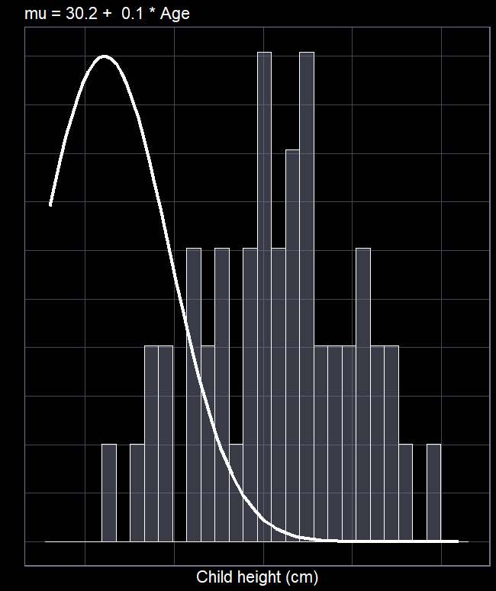

Goal of statistics
We want to tweak the distribution such that the idealised distribution (the “likelihood”) overlaps the real data
How do we tweak the distribution?
Change the mean ($μ$)
How do we change $μ$?
$μ_{i}=β_{0}+β_{1}×X_{i}$
For the child height example, we said:
  $μ_{i}=36.5+14.8×Age_{i}$

Slide 15
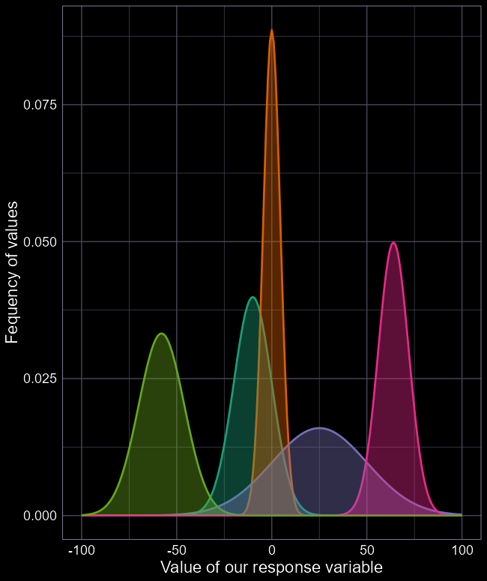


The $Normal$ distribution
When using a $Normal$ distribution a big assumption we make is:
  The average and range can be anywhere from negative infinity to positive infinity
  Meaning the model can predict negative values
    E.g. children could be -5 cm tall
    Not a problem so long as mean and SD are “far” from zero

Slide 16
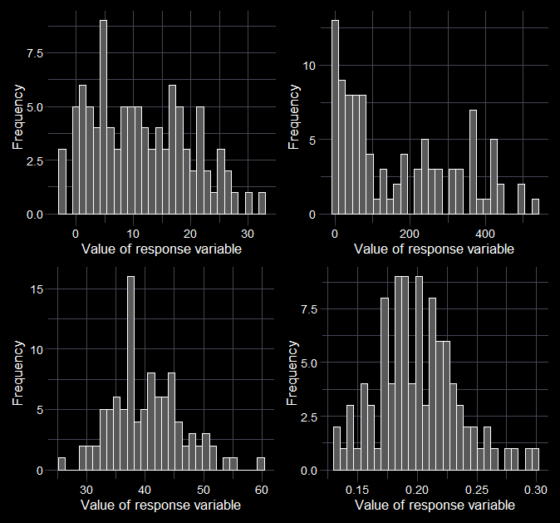




Beware the histomancer
Don’t plot histograms or do tests to “determine” the distribution.
Think about the data:
  What kind of values could I measure?
  Are there limits to the values I could measure?
$$Normal$$
$$Normal$$
$$Poisson$$
$$Beta$$

Slide 17
“Do you drink coffee?”

Slide 18

From a culture where drinking coffee in the morning is normal?
Parents drink coffee
Did you drink coffee yesterday?
Watched TV where mature characters drank coffee?
Was nostalgic for grandparent’s coffee?
Wanted to emulate characters?
Grandparent used to grind coffee by hand?
Drinks tea instead of coffee?
Grandparent’s room had butterflies in the wallpaper?
Believe drinking coffee helps with a hangover?
Saw a butterfly this morning?
Is hungover?

Slide 19


If you drink coffee, what is the average number of coffees you drink in a year?
The response will be a value (e.g. 522.6).
Given your answer, the more interesting question is why do you drink that many?
For each of us, there is some unknown average number of coffees, that we drink in a year,
which is determined by some set of
explanatory variables.
$$y_{i}∼Normal(μ_{i}, σ_{i})$$
$$μ_{i}=Xβ$$

Slide 20
Our experimental design
Given control or treatment

Slide 21

In our experiment, does treatment or control drink more coffee?
$$y_{i}∼Normal(μ_{i}, σ_{i})$$
$$μ_{i}=β_{0}+β_{1}×Treatment_{i}$$

Slide 22
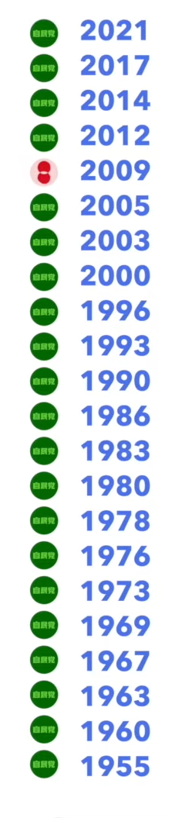

First amongst equals
Three broad purposes of statistics:
Causal inference
Prediction
Descriptive
Based on the data, who do you think won the 2021 Japanese election?
$$Result_{i}=β_{0}+β_{1}Red_{i}$$
LDP have won $\frac{20}{21}=95\%$
Descriptive model: LDP have won 95% from 1955 to 2017
Predictive model: LDP have a 95% chance to win 2021
Causal model: Red colour reduces chance to win by 90%
Linear models (and GLMs) can do all three

Slide 23
The return of hidden assumptions

Slide 24

Monkey’s paw
The Monkey’s Paw is a short story from 1902 by W. W. Jacobs.
A family come into possession of a wish granting monkey’s paw. They wish for £200. The son goes to work the next morning but dies on the job. The parents get £200 compensation.
Relevance to stats:
Models will (almost) always answer your question. Just because you get an answer, doesn’t mean it’s what you wished for. In stats, you will rarely know if you have suffered the Monkey’s Paw.

Slide 25
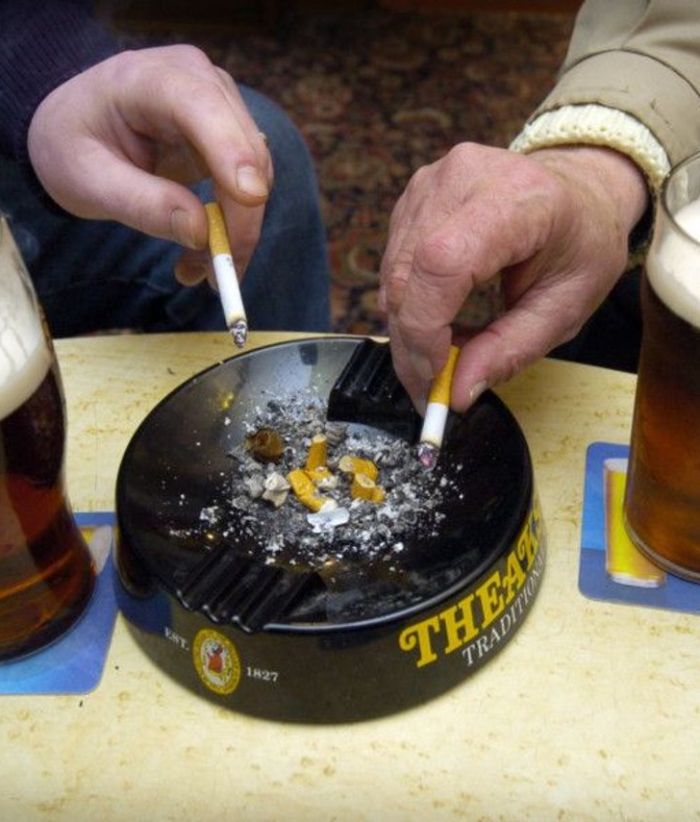
Assumptions
Assumptions help us interpret the world
  Banning smoking in pubs reduced exposure to secondhand smoke
  We assume people smoked in pubs before the ban
Imagine your friend says “I’m fine”
  If you assume they tell the truth, then you believe them
  If you assume they tend to hide their feelings, your interpretation changes

Slide 26

Assumptions in the scientific workflow
We always make assumptions when doing science
  Often, scientists don’t know all of the assumptions they are making
We make assumptions at multiple stages:
  Assumptions about data relevance
  Assumptions about model structure
  Assumptions about residual error

Slide 27
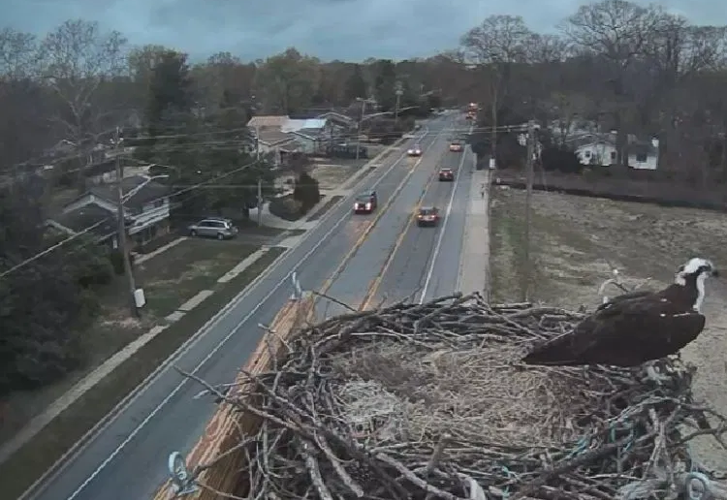
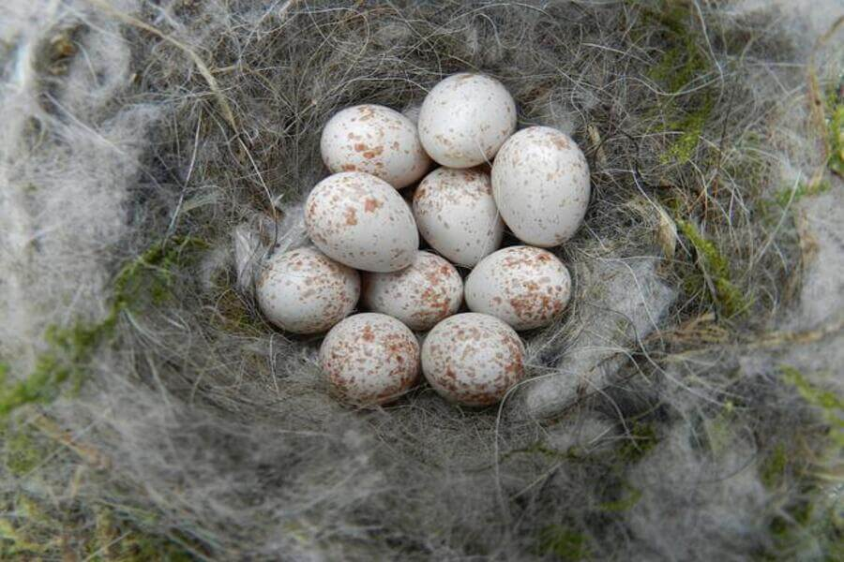
Assumption of validity
Do nests closer to roads produce fewer chicks?
You count how many eggs produced in each nest
What is the issue?
  Number of chicks matters, not how many eggs are produced (Not valid)
What is the consequence?
  Your model is not answering your question

Slide 28
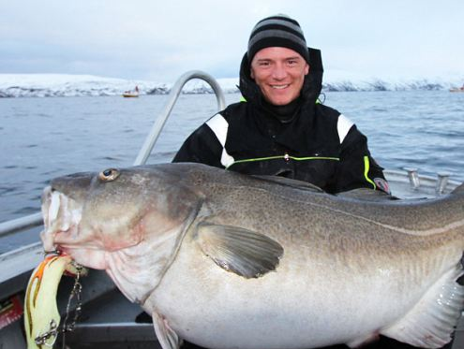
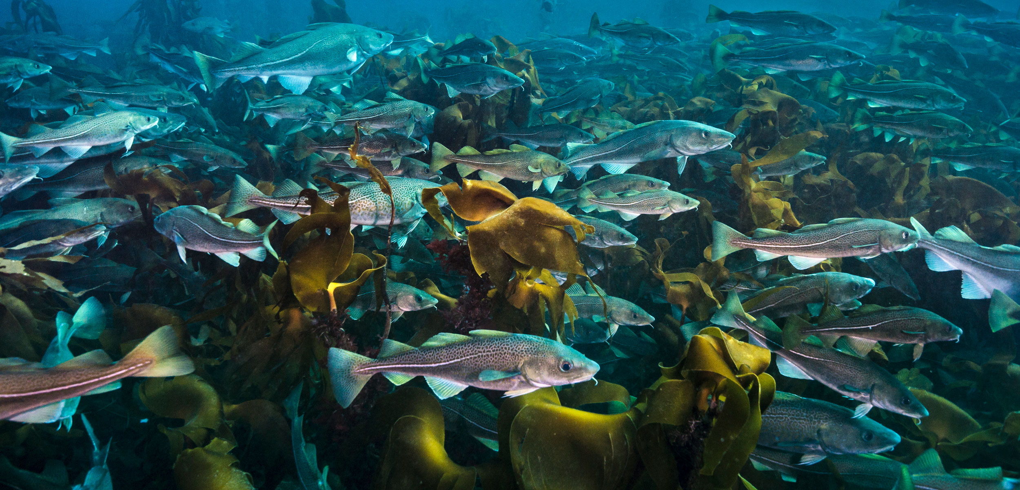
Assumptions of representativeness
What is the growth rate of Atlantic cod?
You measure growth of fish caught in good habitats
What is the issue?
  Cod will grow faster in good habitat (Not representative)
What is the consequence?
  Your answer is biassed

Slide 29
Assumptions in the scientific workflow
Assumptions about data relevance
  Validity and Representativeness
Assumptions about model structure
Assumptions about residual error

Slide 30

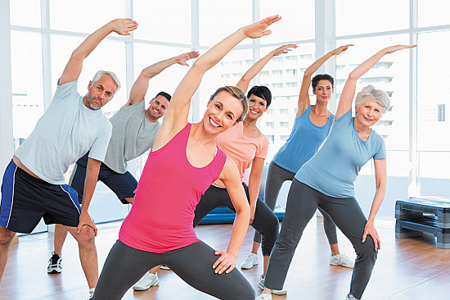
Assumption of addivity
Do food supplements and exercise improve muscle growth in humans?
You look at the effect of food and exercise separately
What is the issue?
  Eating supplements without exercise will do nothing. Gains occur when both occur at the same time - their effects interact or multiply (Not additive)
What is the consequence?
  You might miss key patterns with an overly simplistic model

Slide 31
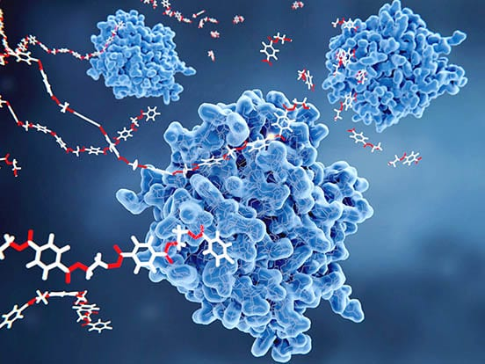
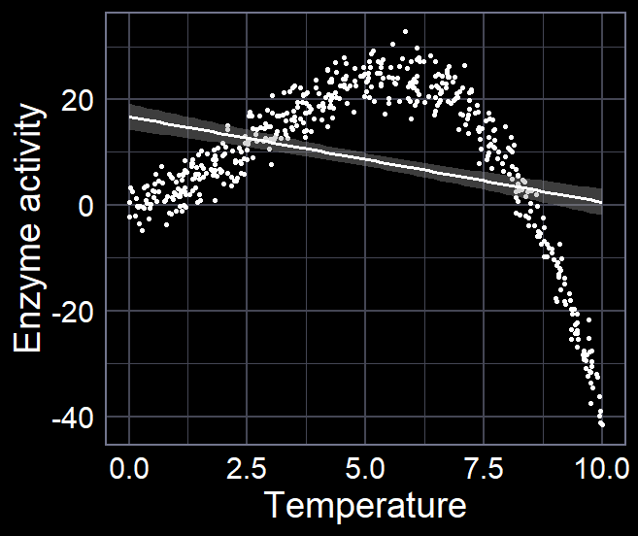
Assumption of linearity
What is the temperature on enzyme activity?
You fit a model that assumes a straight line will describe the relationship
What is the issue?
  The relationship is not linear
  (Not linear)
What is the consequence?
  The model might be nonsense

Slide 32
Assumptions in the scientific workflow
Assumptions about data relevance
  Validity and Representativeness
Assumptions about model structure
  Additivity and Linearity
Assumptions about residual error

Slide 33
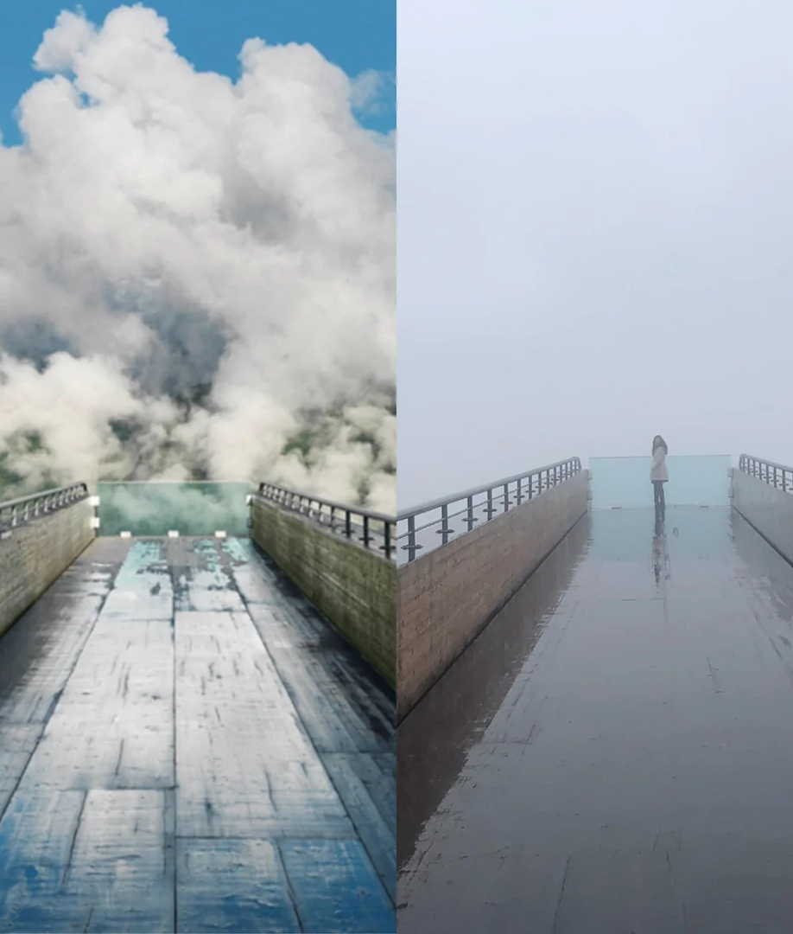
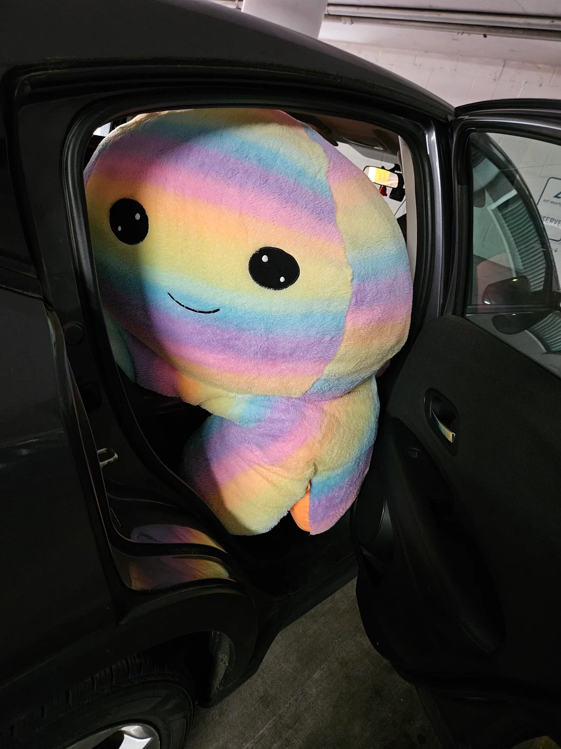
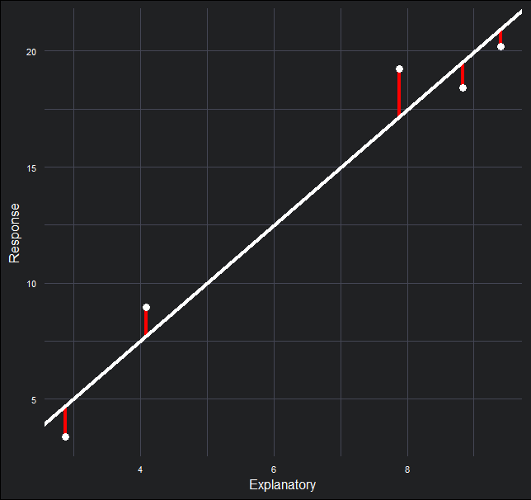
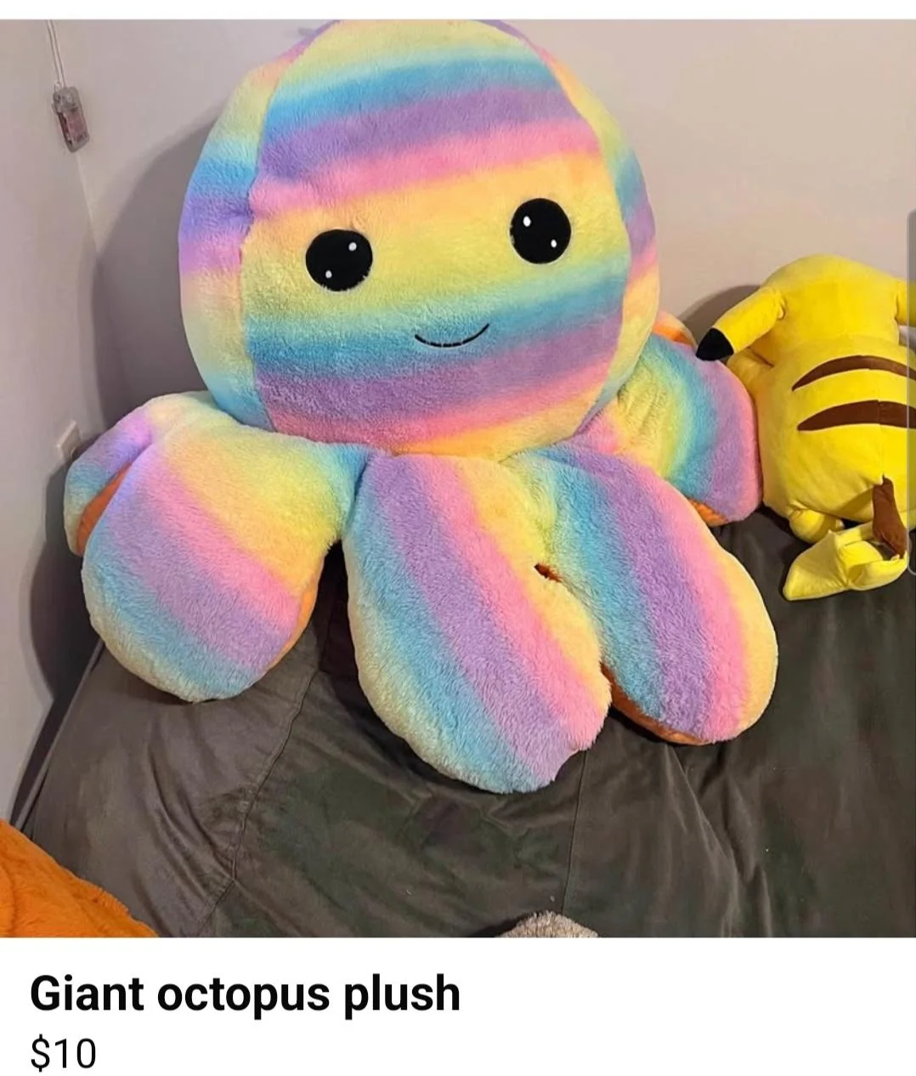
Residual error
Reality
Residual error is, crudely, how “wrong” a prediction is for its corresponding observation
We do not want any patterns in residuals!
Residual
error
Expectation

Slide 34
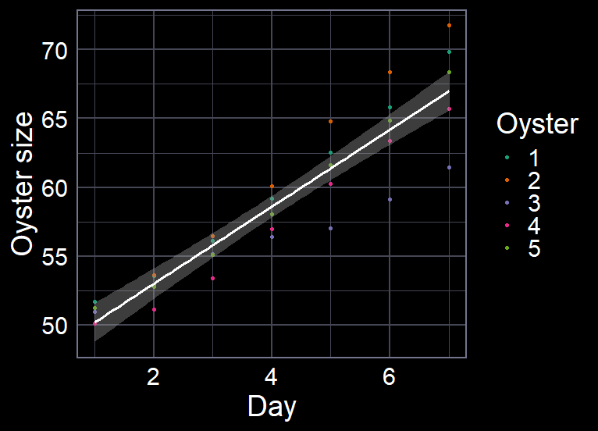
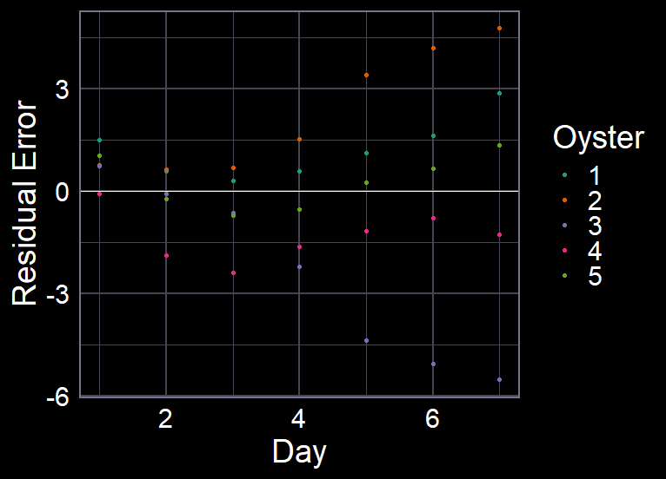
Assumption of independence of errors
What is the average daily oyster growth rate?
You measure the same oysters every day
What is the issue?
  The growth of the oyster yesterday affects how much the oyster can be grow today
  The errors in our model follow a pattern rather than being random (Errors not independent)
What is the consequence?
  The model is overly confident

Slide 35
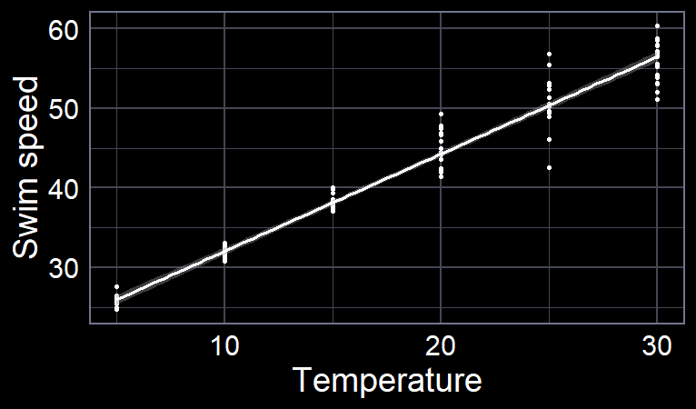
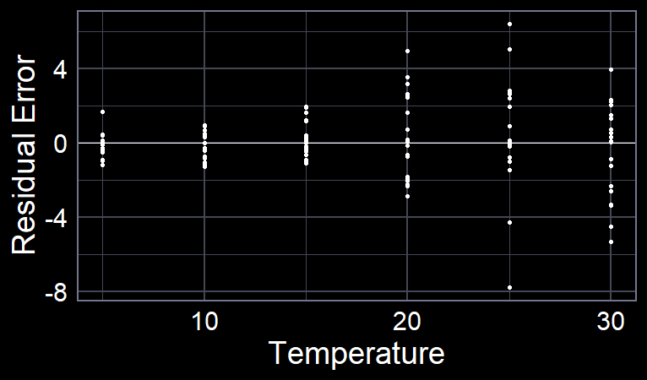
Assumption of equal variance of errors
Does temperature predict dolphin swimming speed?
You measure speed at low and high temperatures
What is the issue?
  At higher temperatures, dolphin vary more in their speed
  The errors in our model get larger at higher temperature rather than being random (Errors not equal)
What is the consequence?
  The model is either overly confident or overly conservative

Slide 36
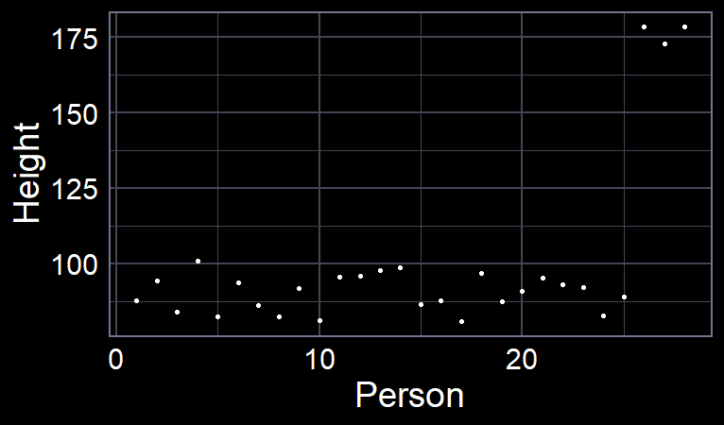
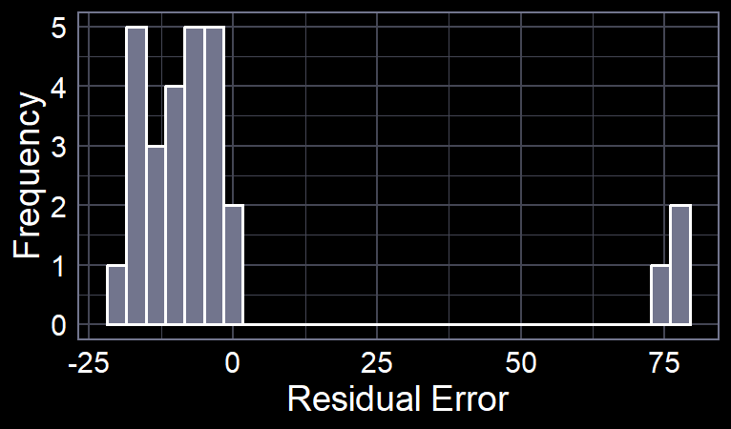
Assumption of normality of errors
What is the average height of a human in a kindergarten class?
You measure the height of everyone in the class, including staff
What is the issue?
  Most of the humans are short (children) but 3 are tall (adults)
  We have a pattern, where the errors are not bell-shaped
  (Errors not normally distributed)
What is the consequence?
  The model struggles to predict observations accurately
  (not that big of a deal)

Slide 37
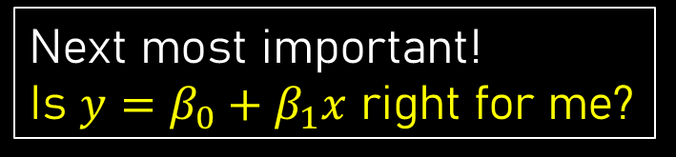
Assumptions in the scientific workflow
Assumptions about data relevance
  Validity and Representativeness
Assumptions about model structure
  Additivity and Linearity
Assumptions about residual error
  Independence of errors, Equal variance of errors, and Normality of errors
Most important!
Is my data appropriate?
Next most important!
Is $y=β_{0}+β_{1}x$ right for me?
Least important.
When my model is wrong,
is it wrong in the “right” way?
Dealing with these issues is the core of a well-designed study!

Slide 38

TL;DR
We choose a distribution to state what the data should look like and how variation should work
  The $Normal$ is a common one (but not the only one)
  $y_{i}∼Normal(μ_{i}, σ)$
We use a linear equation to say what determines the average ($μ$)
  $μ_{i}=β_{0}+β_{1}x_{i}$
When we fit these models, we make various assumptions
  Assumptions about the data are most important
    Are we measuring the right thing, in the right way?
  Assumptions about the model structure is next most important
    Does our model match reality?
  Assumptions about residual errors are least important
    Are the “mistakes” behaving as we expect?

